Slide 1
Student Design Competition
Capstone Design
ME 4902.01 and 4902.02
Shawn Midlam-Mohler
Professor of Practice
midlam-mohler.1@osu.edu
Notes:
Success in domestic fellowship students is good. Need to improve success in international fellowship acceptances
15 + spring quarter grads. Hopefully it will be in the 20’s
20% at PhD level. Need to enhance quality as well

Slide 2
S.D.C. Capstone Overview
The College of Engineering hosts a wide range of student design projects:
http://engineering.osu.edu/studentorgs
Students involved in these activities can use the content as their capstone design project:
  A student design team of 3-6 seniors is created
  The project gets the approval of the course instructor
  The student design team finds an appropriate technical advisor for the project (usually Dr. Midlam-Mohler)

Slide 3
Student Design Competitions
Motorsports Projects:
  Formula SAE
  BAJA SAE
  Buckeye Bullet
  EcoCAR Mobility Challenge
  Electric Motorcycle
  Supermileage
Other Design Competitions:
  Buckeye Space Launch Initiative
  Underwater Robotics

Slide 4
S.D.C. Capstone Overview
The course sequence results in 2 full semesters of working on your project – the first 7 weeks are planning intensive but the rest of the course is largely self-directed work
It is possible to form interdisciplinary teams via other majors taking the ENG capstone sequence
Funding for these projects comes out of already available team budgets (i.e. need faculty advisor approval) and external donations (typically $2500 is reimbursed to the teams)
Distinguishing Feature:
In this capstone course, your team is imbedded in within a larger team that is competing on a national stage. Risk happens. Change happens. Your project rolls up into a larger project and may be on the critical path.

Slide 5
Recent Projects
Buckeye Bullet:
  Battery Pack Design, 400 Mph Tire Tester, Vehicle Lift, Body Panel Attachment
EcoCAR:
  Battery Pack Design, Automated Manual Transmission Actuation System, Automated Manual Transmission Test Rig, Engine EGR and VVT Control, Vehicle Ride and Handling Improvement, Vehicle Charge Port Integration, Composite Hood, Composite Trunk Lid, Light-Weight 12 V System, Light-Weight Exhaust, Hybrid Camaro Suspension, Electric Motor Coupler
Formula SAE:
  Brake Tester, Aero Package, Active Aero Package, Engine Performance, Vehicle DAQ System, Tire Model Software
Current:
  CAN-Based DAQ, Motorcycle Service Lift, EV Frame Design, Cooling System Design, Traction Control System
Baja:
  Rugged DAQ and Instrument Package, Adjustable Sway Bar, Electronically Variable Transmission
Supermileage:
  Electronic Fuel/Spark Control for Improved Efficiency, Series Hybrid PT

Slide 6
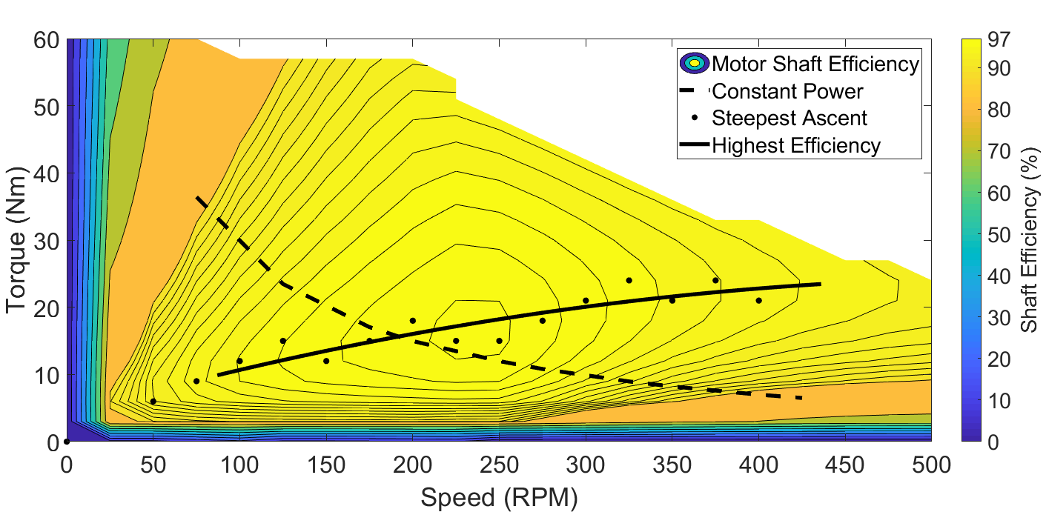
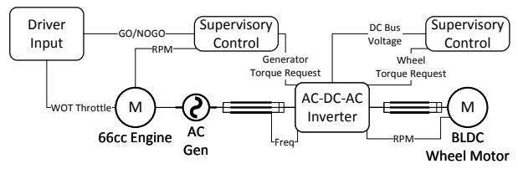
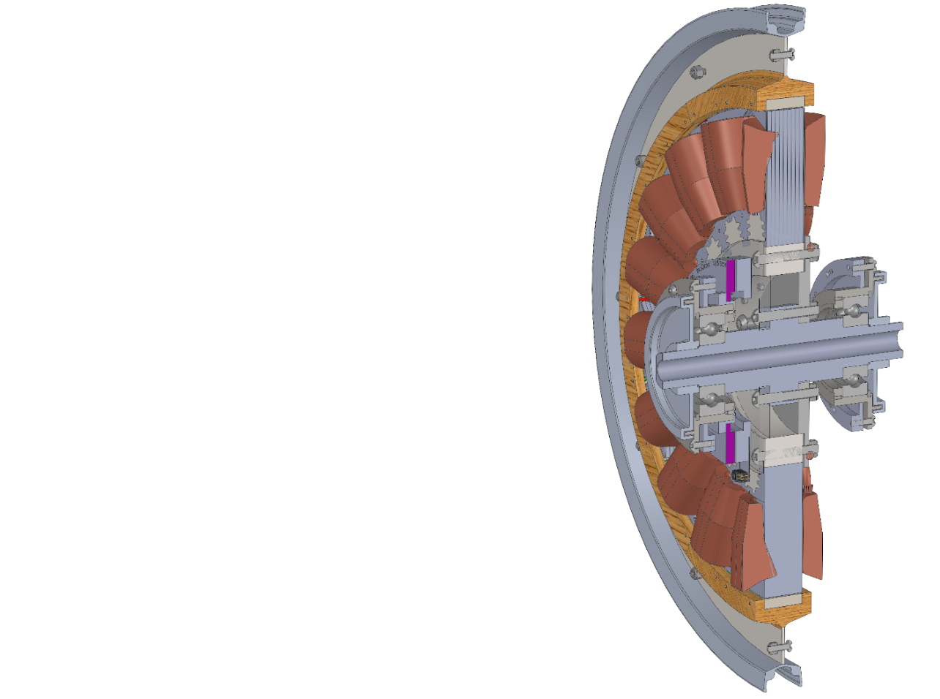
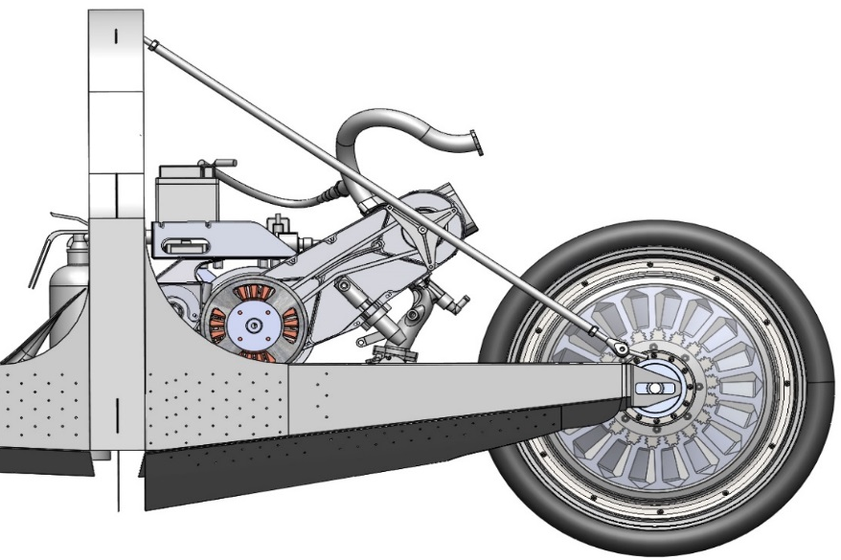
Figure 1: System Diagram
Figure 2: Wheel Motor Torque-Speed Curve
Figure 3: Custom BLDC Wheel-Motor
Figure 4: Drivetrain System CAD

Slide 8
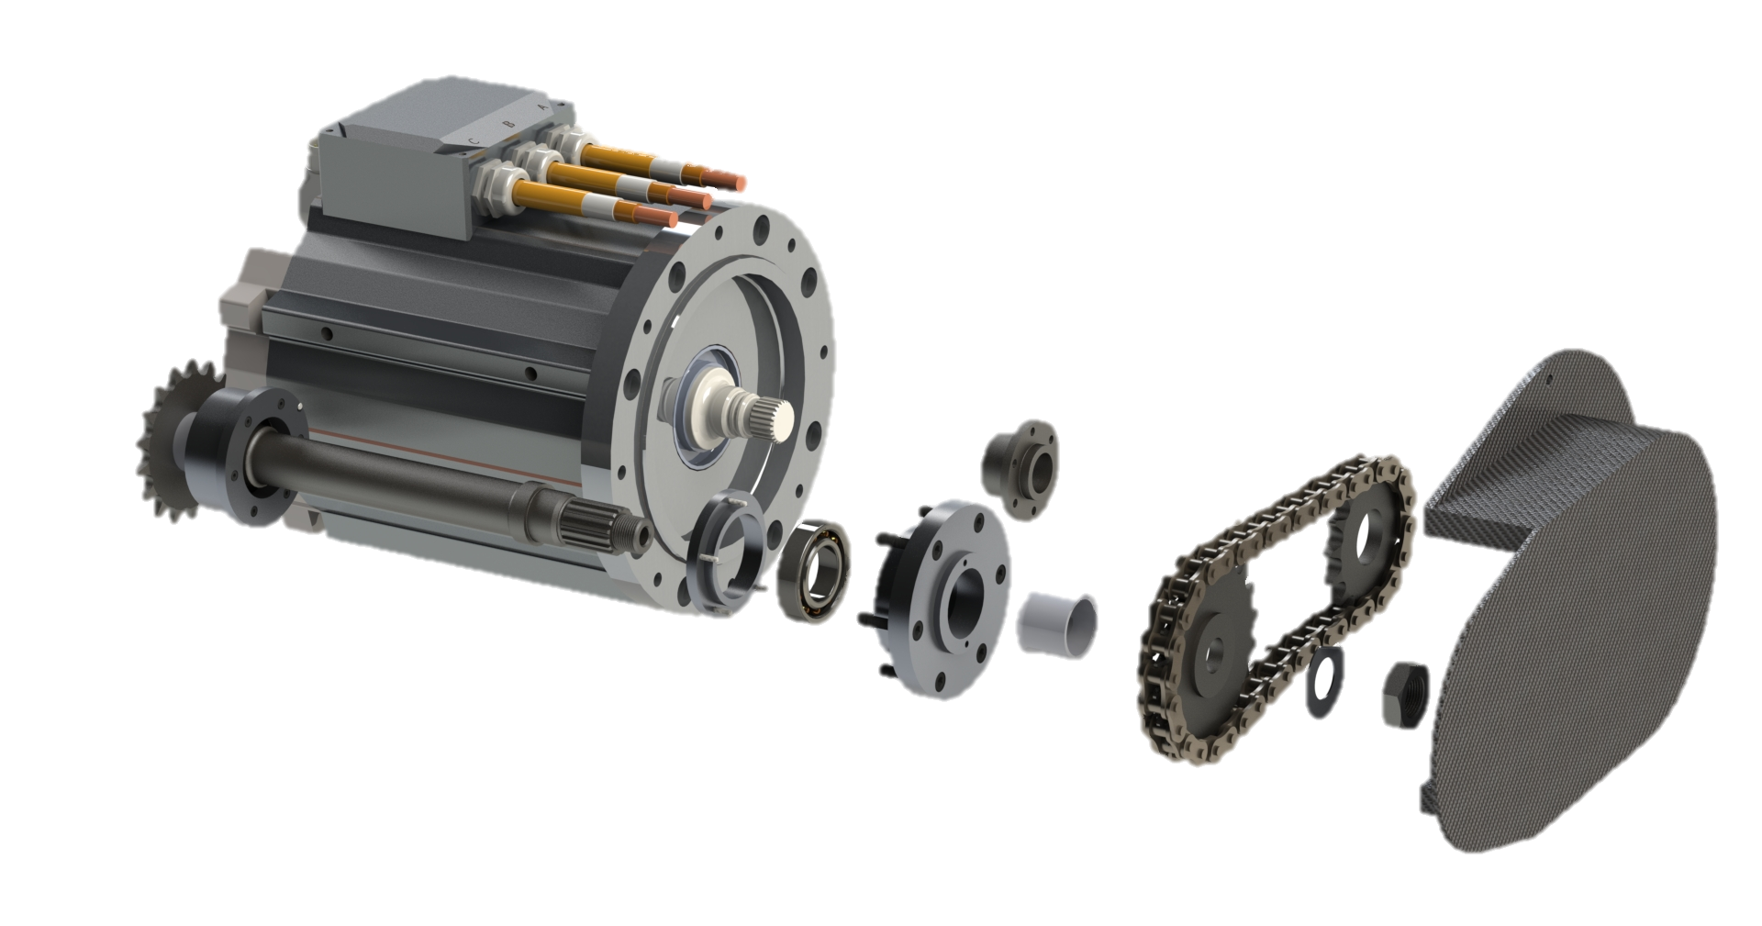
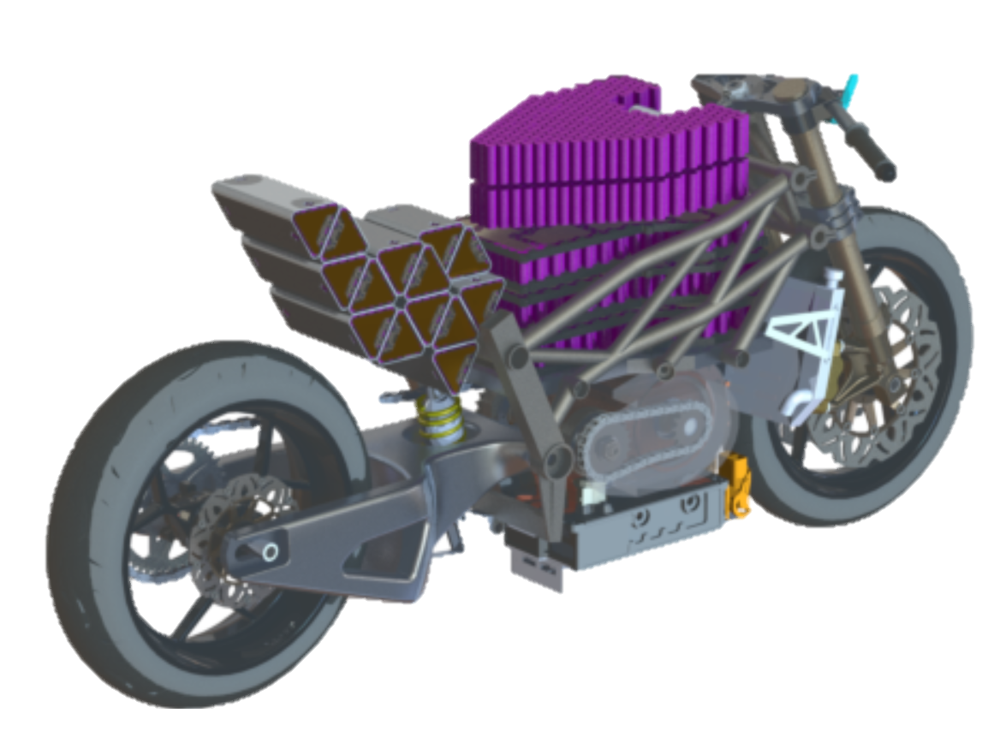

Slide 9
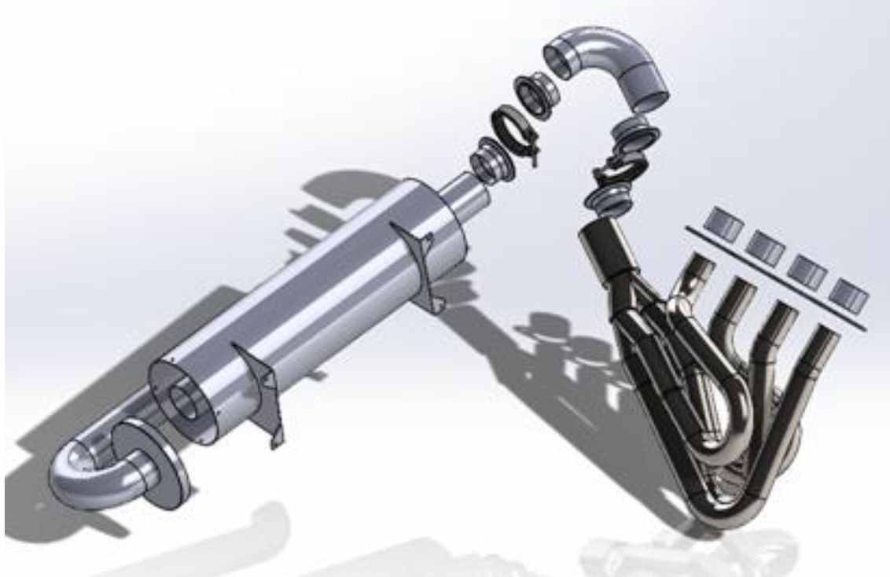

Slide 10
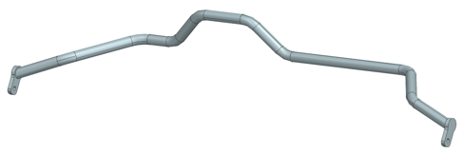
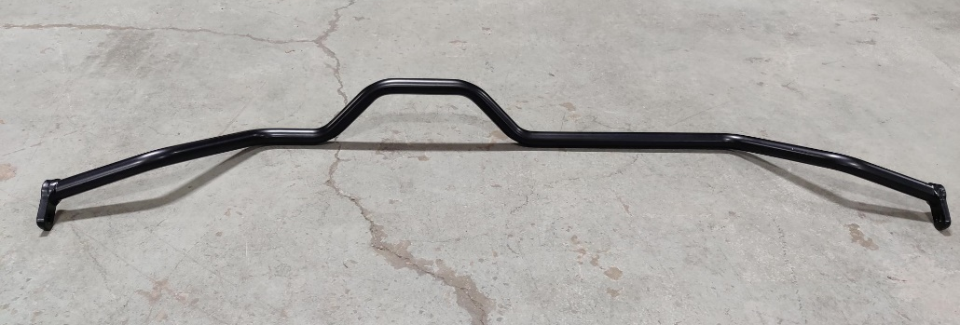
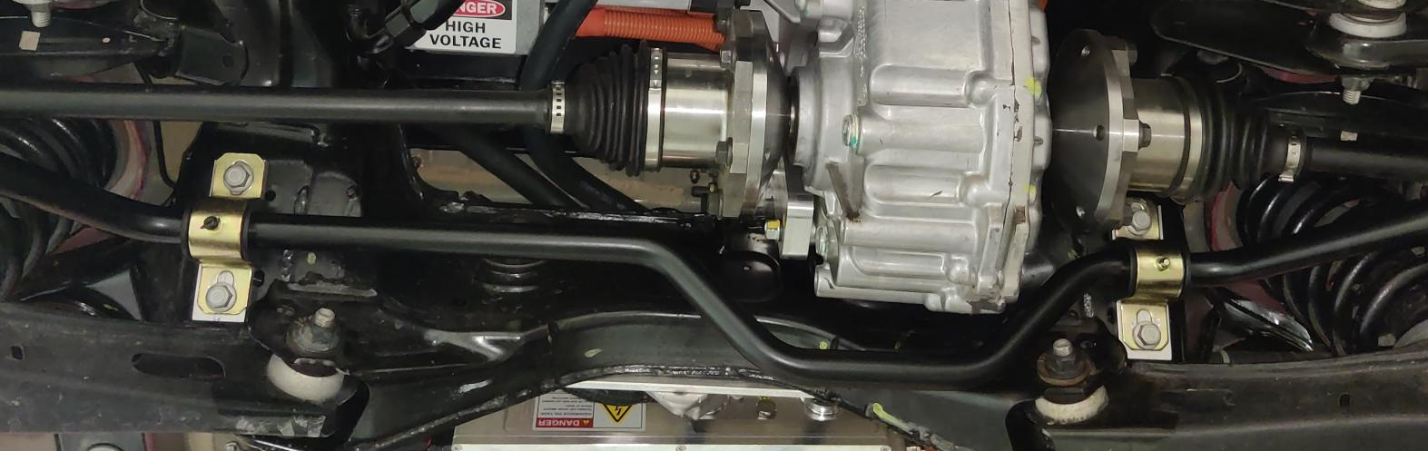

Slide 11
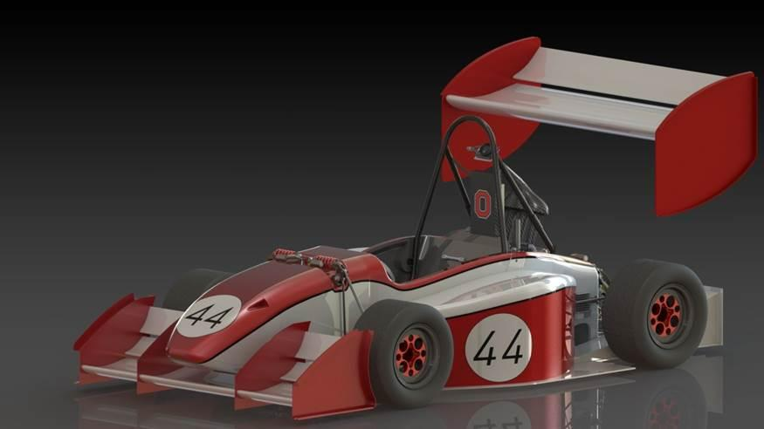
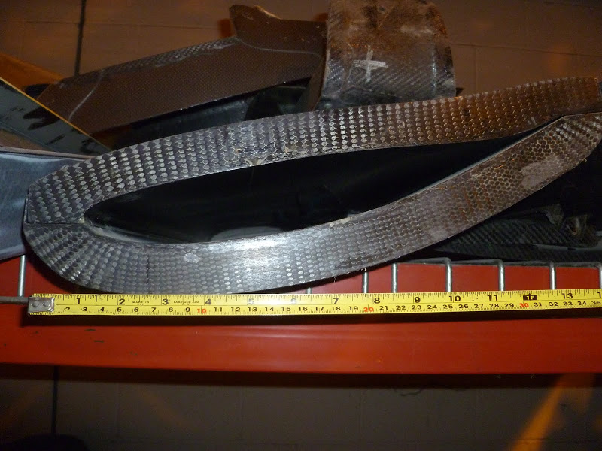
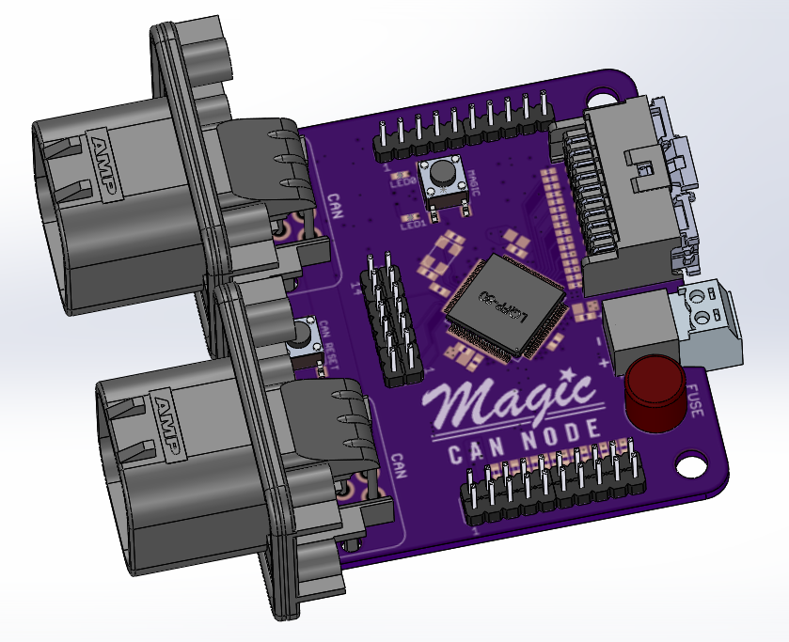
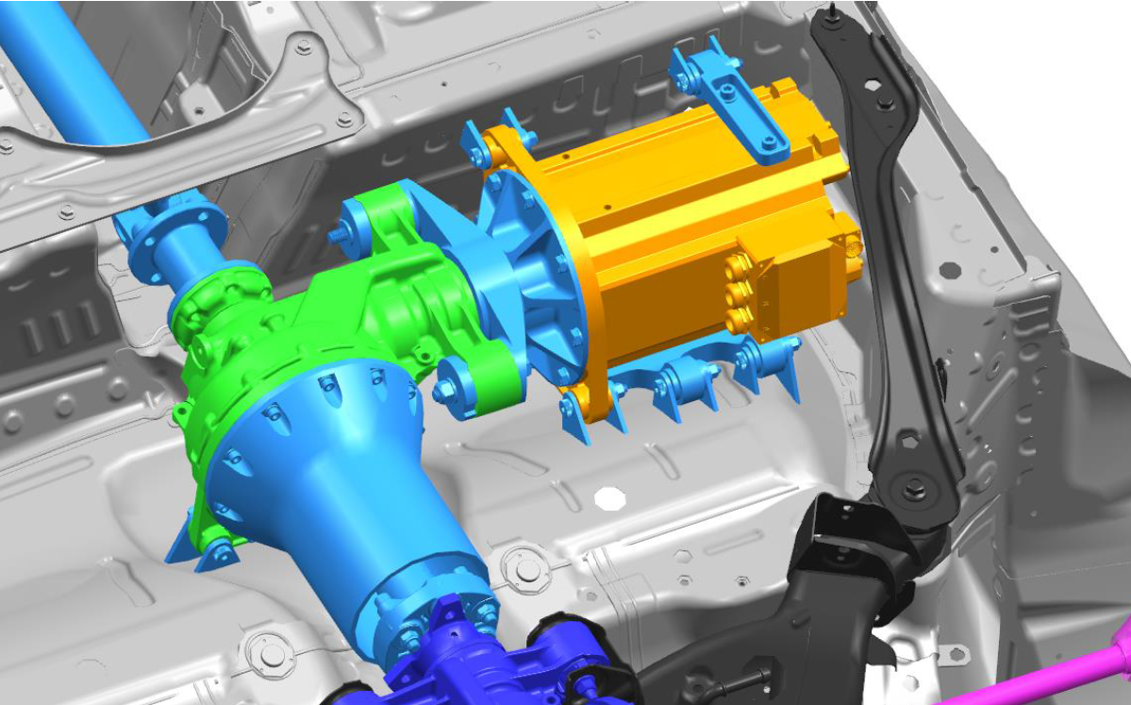

Slide 12
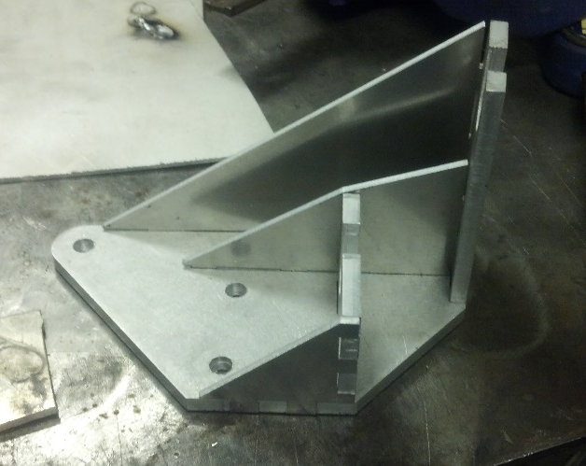
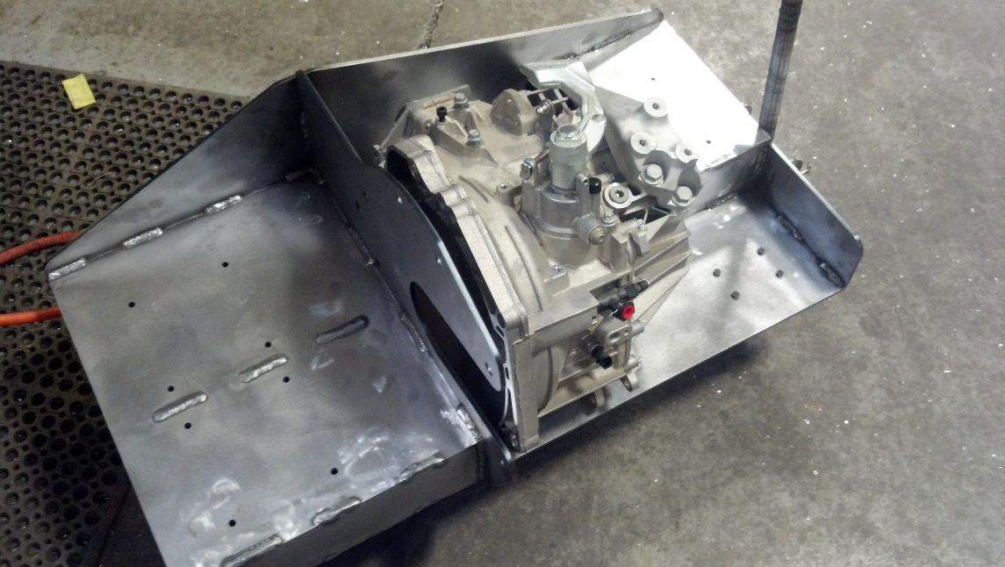
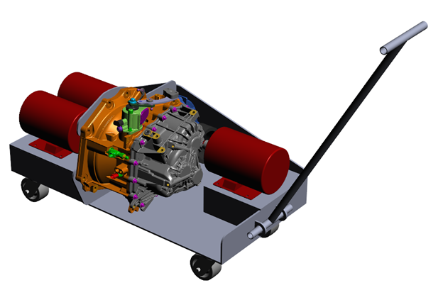
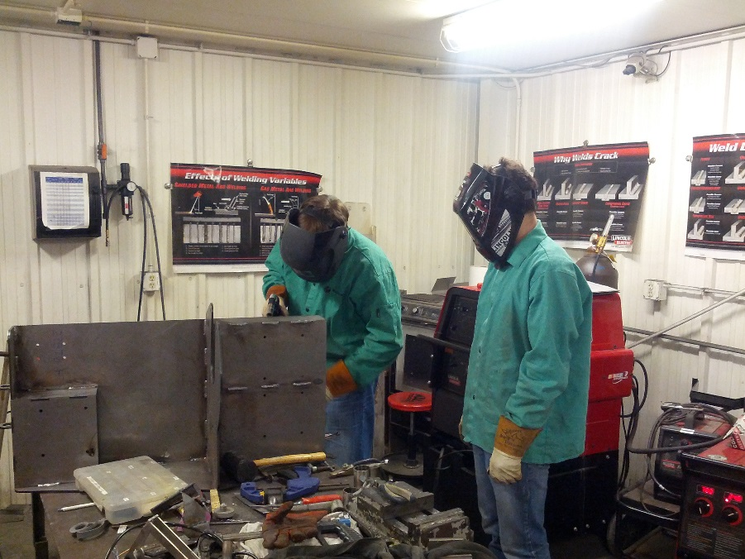

Slide 13
How to Enroll
This section is by permission of instructor only
If you are on a design competition team already:
  Send me a resume and a statement of what you do on the team currently
If you are not on a team but are interested in this capstone:
  Send me a resume and a short statement of why you are interested in this experience
The title of the email needs to have “ME4902” in the subject – I batch process students weekly and will send an email to you with permission to enroll
  Shawn Midlam-Mohler
  midlam-mohler.1@osu.edu

